Slide 1


Customer Reviews Classification
Submitted by:
Abdellah Ennajari
Abdellatif Chakor
Yassine Ben Acha
Supervisor: Dr. Bentaleb Asmae
Jury:Dr. Alami Nabil
Academic Year: 2024/2025

Slide 2




Timeline
Training Classical Machine Learning Models
Conclusion
Introduction
Data Preparation and Preprocessing
Training and Evaluation for RoBERTa and XLNet

Slide 3
Data Preparation and Preprocessing

Slide 4
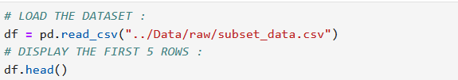
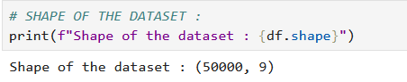
Data Preparation and Preprocessing :
The objective of this section is to perform essential data cleaning and preprocessing steps to prepare the customer review dataset for sentiment analysis.
Load the Dataset :
Dataset Overview :

Slide 5
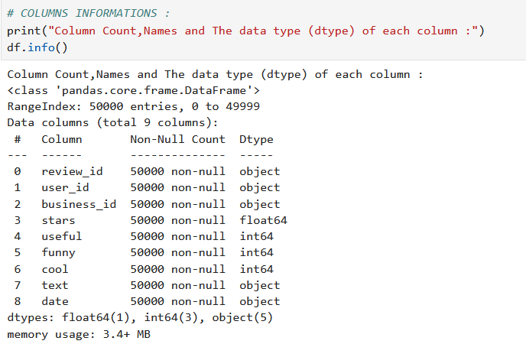
Data Preparation and Preprocessing :
Dataset Overview :

Slide 6
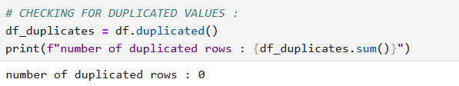
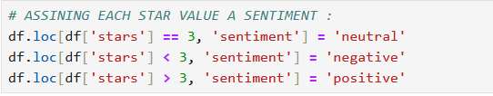
Handling Duplicated Values :
Target Variable Distribution :

Slide 7
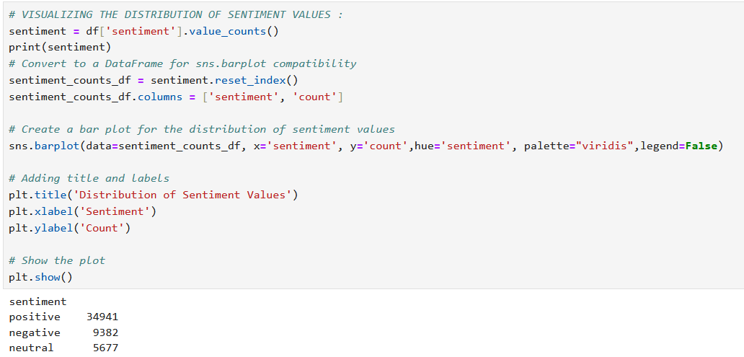
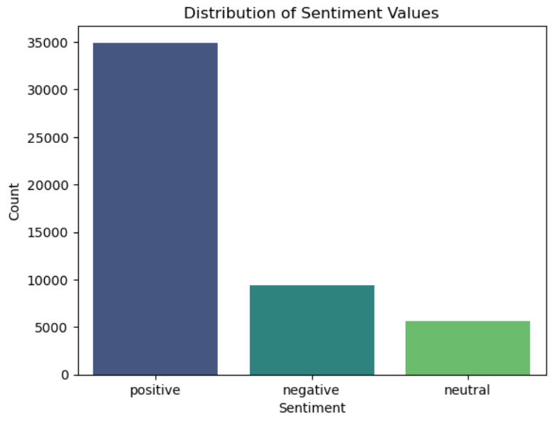
Visualizing the distribution of sentiment :
This distribution shows how customer opinions are spread across different sentiment categories, with positive reviews dominating, followed by negative reviews, and neutral reviews making up a smaller portion.

Slide 8
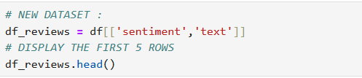
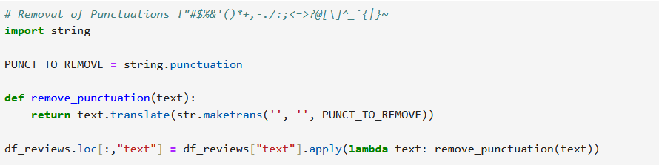
Text Preprocessing :
Before we start, we will create a new dataset with only the relevant columns for our analysis :
Convert Text to Lowercase :
Remove Punctuations from Text :

Slide 9
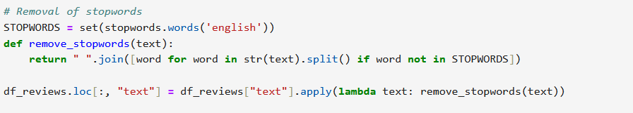
Remove Numbers from Text :
Handle newline and carriage return characters:
removing stopwords helps improve the quality of analysis by focusing on the words that hold the most meaning for understanding the text.such as "the", "is", "in", "and", "at" for english

Slide 10
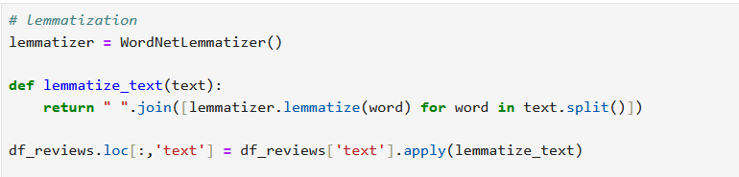
Text Lemmatization :
Lemmatization is a text preprocessing technique that reduces words to their base or root form (called a "lemma"), it also considers the word's meaning and context.
We also have stemming, which simply chops off prefixes or suffixes to reduce words.
lemmatization is generally preferred for tasks like sentiment analysis where the meaning of the word is important.
Text tokenization is the process of splitting a string of text into smaller units, typically words or phrases, called tokens.
Tokenization breaks down text into individual words, making it easier to analyze and understand the meaning of each word in a review

Slide 11
Relationship Between Sentiment and Length of Text :
Text tokenization is the process of splitting a string of text into smaller units, typically words or phrases, called tokens.
Tokenization breaks down text into individual words, making it easier to analyze and understand the meaning of each word in a review.
The objective of analyzing the relationship between sentiment and text length is to understand whether the length of a review is related to its sentiment (positive, negative, or neutral).

Slide 12
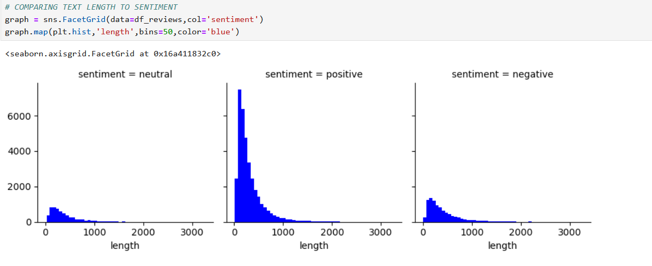
Relationship Between Sentiment and Length of Text :
we observe that positive reviews tend to have longer text lengths, indicating that customers may express their satisfaction in more detail.
Negative reviews show a moderate length, suggesting that dissatisfied customers provide sufficient information but not as extensively as positive reviewers.
Neutral reviews, on the other hand, tend to have shorter texts, possibly reflecting more neutral or less detailed feedback.

Slide 13
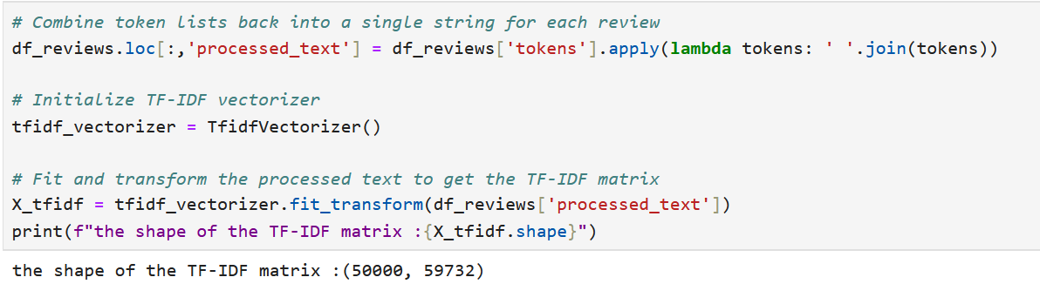
Feature Encoding :
We will use TF-IDF Vectorization (Term Frequency-Inverse Document Frequency) to convert text data into numerical features.
Why Choose TF-IDF?
. TF-IDF assigns higher weights to words that are important in a document.
. It transforms text data into a sparse numerical matrix, making it computationally efficient while retaining meaningful information.
. TF-IDF vectors integrate seamlessly with traditional machine learning algorithms.
How TF-IDF Works ?

Slide 14
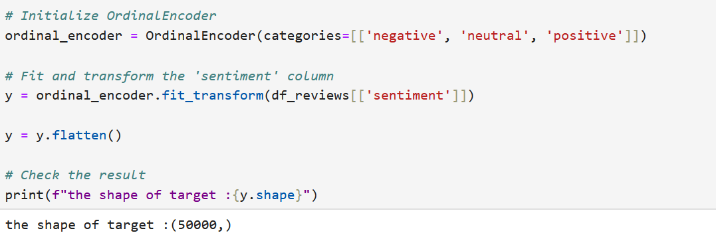
Feature Encoding :
For sentiment column we use OrdinalEncoder from sklearn.preprocessing with a predefined order for the sentiment categories (negative, neutral, positive.

Slide 15
Data Splitting :
ensuring the class distribution of the target variable is preserved (stratify=y) to handle its imbalance.

Slide 16
Training Classical Machine Learning Models

Slide 17
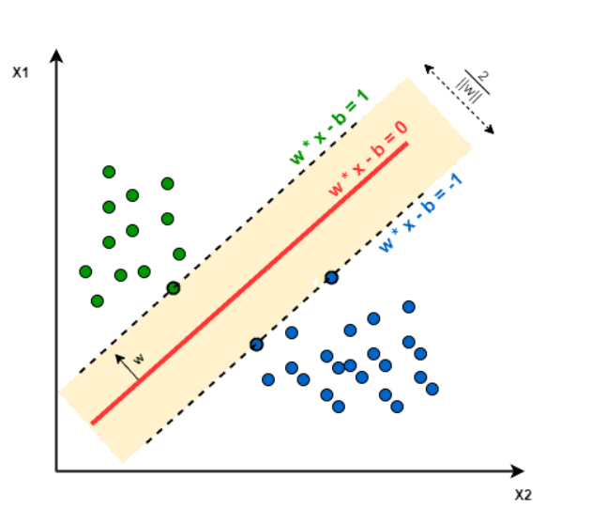
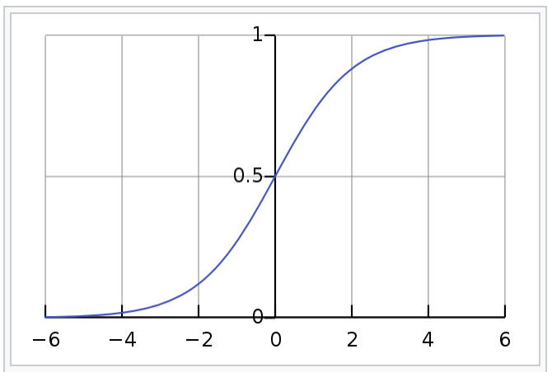
Logistic Regression & SVM
Before starting the next steps of our project, I will give a very brief introduction to our problem and its type.
Notes:
Before starting the next steps of our project, I will give a very brief introduction to our problem and its type.
The problem we are dealing with falls under supervised machine learning, specifically classification. This is because we are working on identifying categories—positive, negative, or neutral.
As part of our research, we explored various classification algorithms to determine which would be most suitable for our case. After thorough analysis, we identified six prominent algorithms: Logistic Regression, Decision Tree, Random Forest, Support Vector Machine (SVM), K-Nearest Neighbors (KNN), and Naive Bayes. These algorithms were chosen based on their efficiency, accuracy, and ability to handle the specific requirements of our classification task. After applying these models, we found that Logistic Regression and SVM provided the best accuracy and predictions, making them the most effective for our problem.

Slide 18
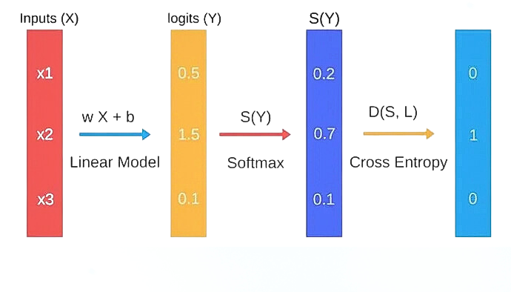
Logistic Regression
Logistic Regression is a supervised machine learning algorithm used for classification tasks. It predicts the probability of a categorical dependent variable
Notes:
Now, let me start by explaining the first algorithm, Logistic Regression. Logistic Regression is a supervised machine learning algorithm used for classification tasks. It predicts the probability of a categorical dependent variable
There are three types of Logistic Regression: binary, ordinal, and multinomial. In our case, we are focused on multinomial regression. Now, let’s break it down and talk about the preprocessing steps and how multinomial Logistic Regression works.
The cost fct we use here to minimize the error is called cross_entropy) (Log Loss)

Slide 19
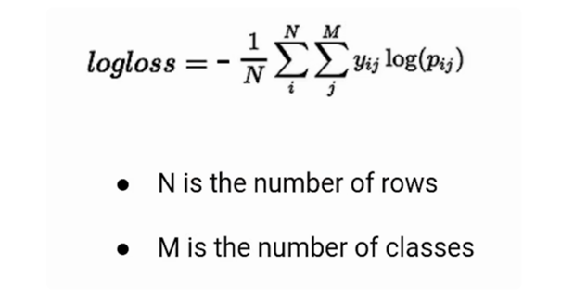
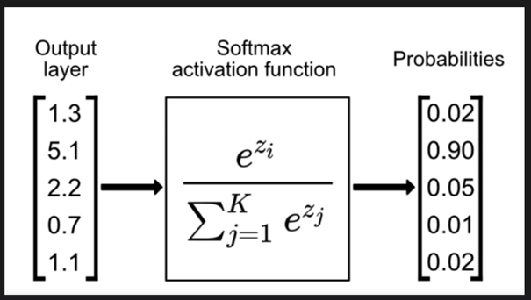
Softmax & Cross_entropy
Notes:
The cost function we use here is called log loss (cross-entropy loss), which helps minimize the error

Slide 20
Support Vector Machine
Support Vector Machine is a linear model for classification and regression problems. It can solve linear and non-linear problems
Notes:
SVM or Support Vector Machine is a linear model for classification
and regression problems. It can solve linear and non-linear problems
hyperplane separates the data into classes.

Slide 21
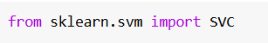
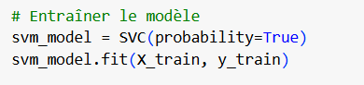
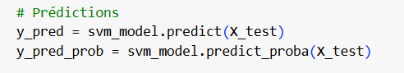
Code Breakdown
Notes:
importing a model svm from the sklearn library
# Entraîner le modèle:
svm_model = SVC(probability=True):
svm_model: This is a variable that holds the instance of the SVC model.
SVC: The SVC class initializes the Support Vector Classifier.
probability=True: By setting this parameter to True, the classifier can calculate probabilities for each class (using predict_proba). This comes at a computational cost.
svm_model.fit(X_train, y_train):
.fit(): This method trains (fits) the SVM model on the provided training data.
X_train: A variable representing the training input data (features). This is typically a 2D array or DataFrame with shape (n_samples, n_features).
y_train: A variable representing the training target labels (output). This is a 1D array or list of class labels.
# Prédictions:
y_pred = svm_model.predict(X_test):
y_pred: This variable stores the predicted class labels for the input test data.
.predict(): This method predicts the class labels for the given data.
X_test: A variable representing the test input data (features) that the model has not seen before.
y_pred_prob = svm_model.predict_proba(X_test):
y_pred_prob: This variable stores the predicted probabilities for each class.
.predict_proba(): This method outputs the probability of each class for each test sample.
X_test: The same test input data.

Slide 22
Training and Evaluation of RoBERTa and XLNet

Slide 23
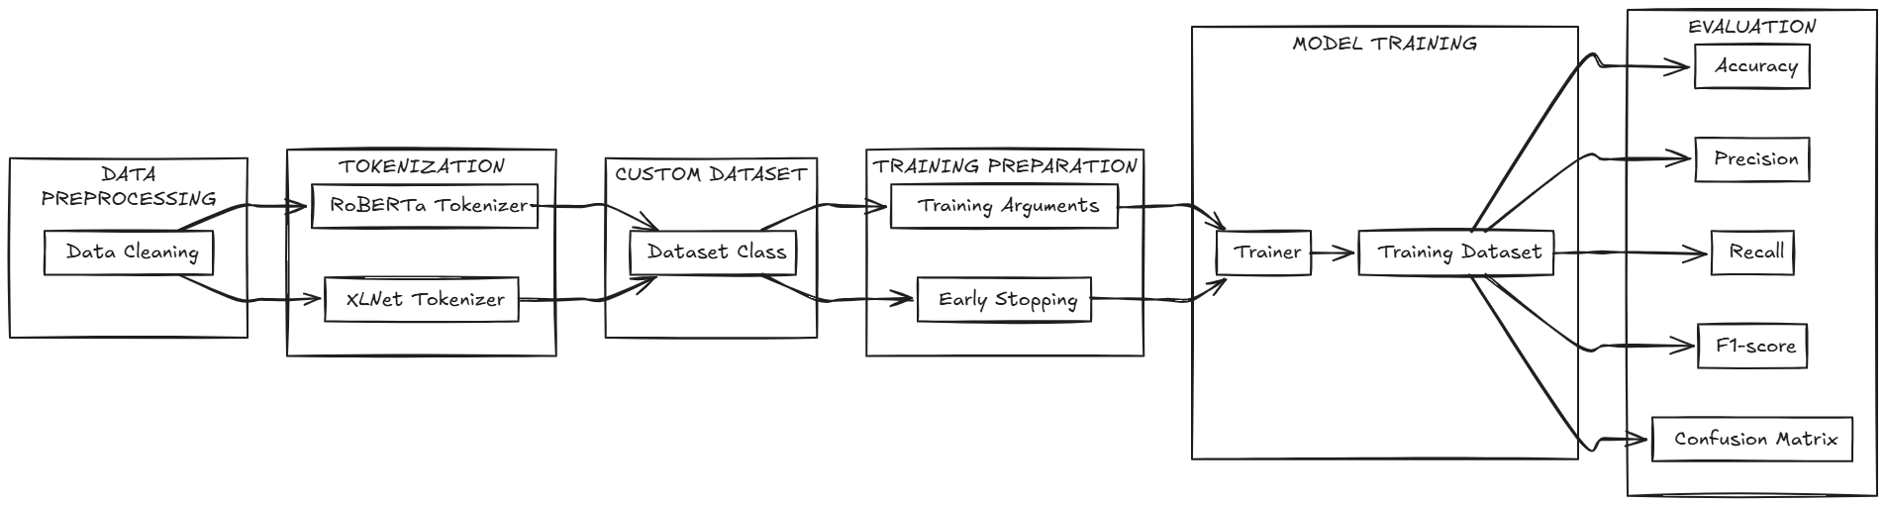
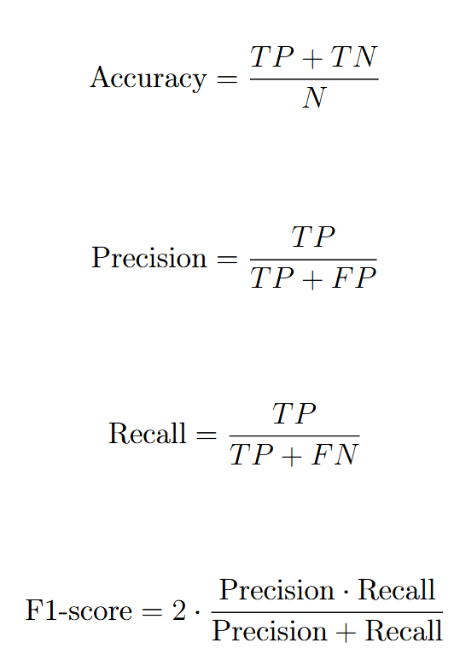
Transfer Learning Architecture

Slide 24
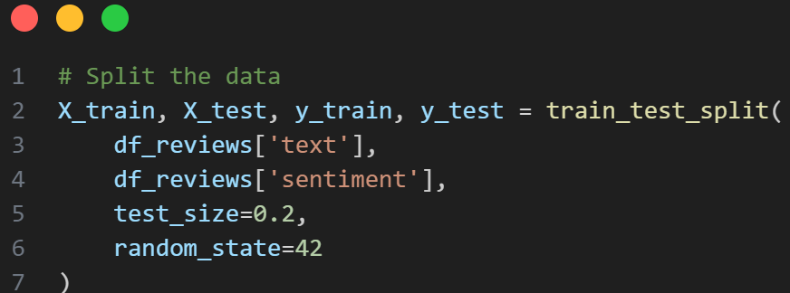
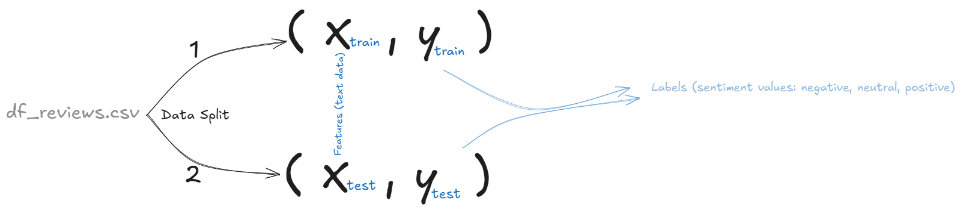
Data Split
df_reviews
X_train, X_test, y_train, y_test
Splits the dataset into training and testing sets using train_test_split from sklearn.model_selection. The df_reviews['text'] column serves as the feature set, and df_reviews['sentiment'] is the target label, with 20% of the data allocated for testing and 80% for training. The random_state parameter ensures reproducibility by setting a seed for the random number generator.

Slide 25
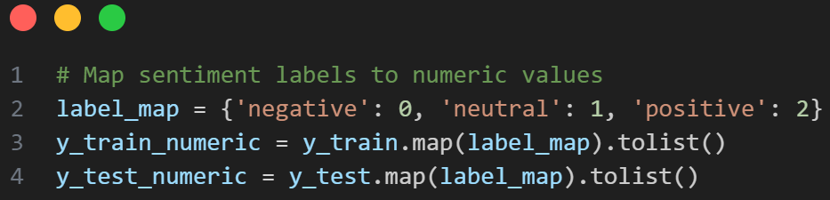
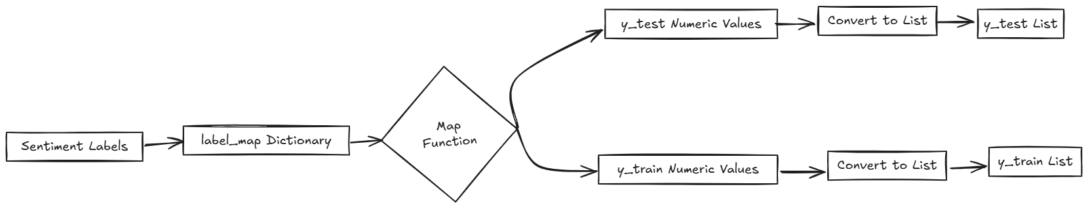
Map Sentiment
Label_map
y_train_numeric
y_test_numeric

Slide 26
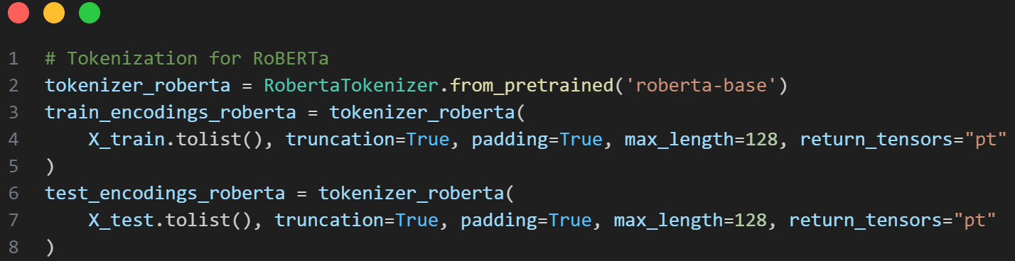
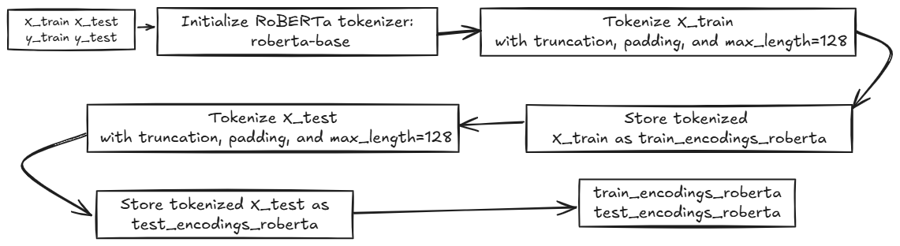
Tokenization
X_train
X_test
y_train
y_test
train_encodings_xlnet
test_encodings_xlnet

Slide 27
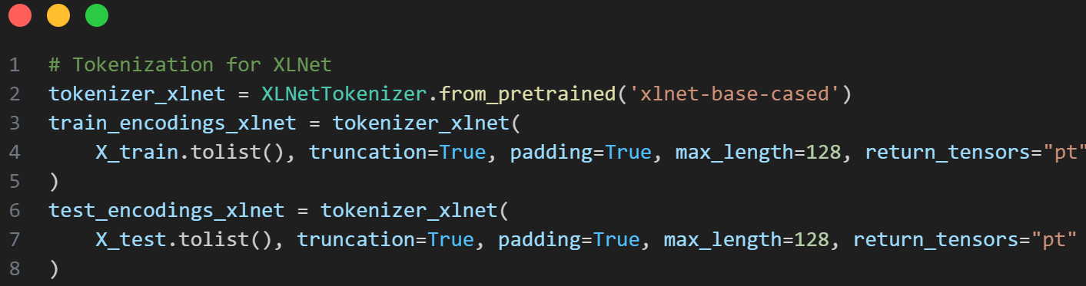
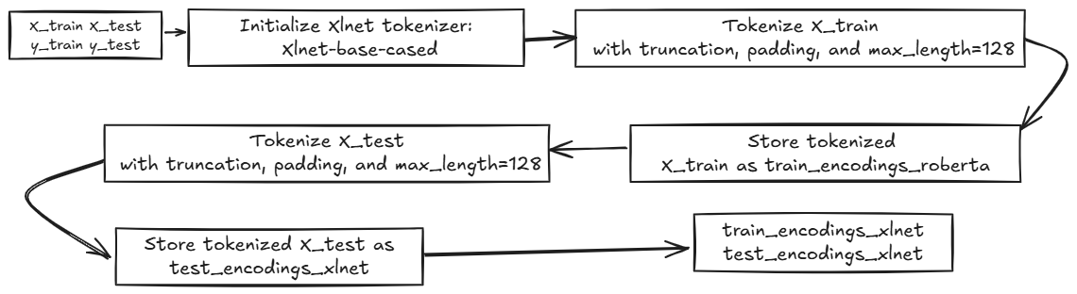
Tokenization
X_train
X_test
y_train
y_test
train_encodings_xlnet
test_encodings_xlnet

Slide 28
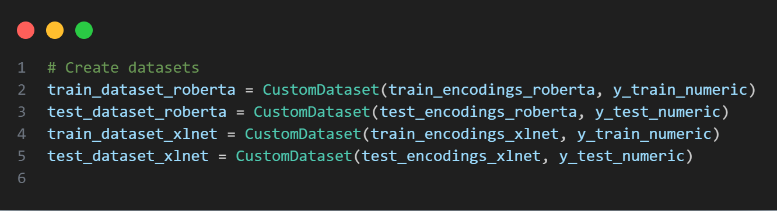
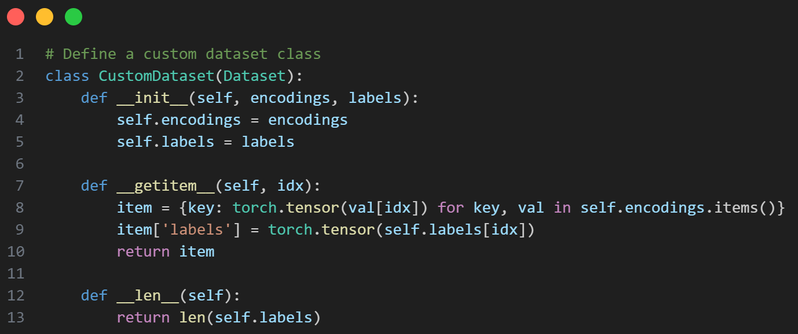
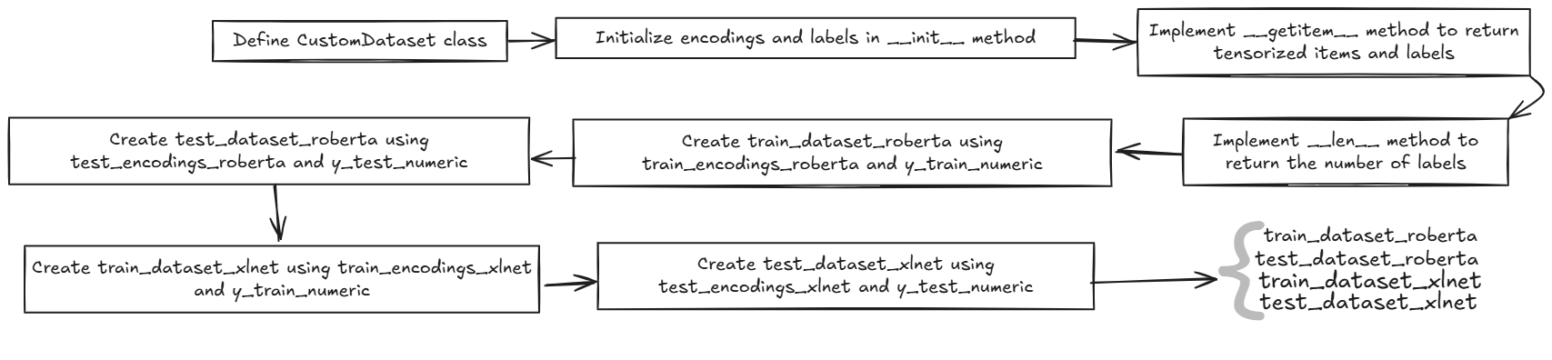
Custom Datase
train_encodings_xlnet
test_encodings_xlnet
train_encodings_xlnet
test_encodings_xlnet

Slide 29
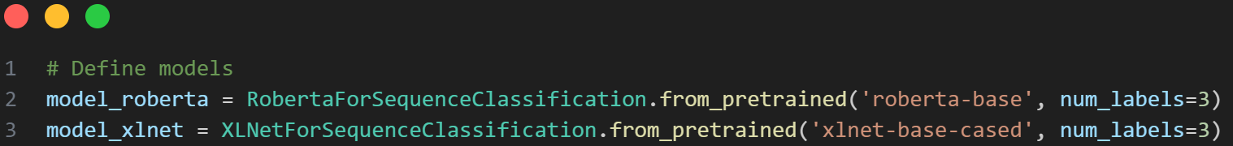
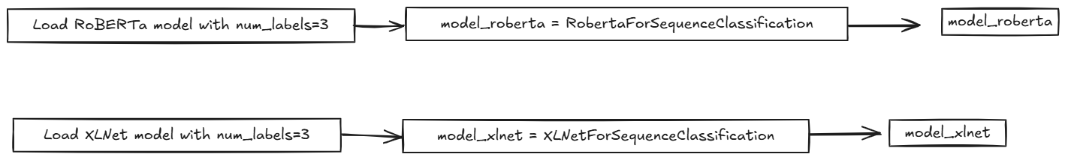
Define models
model_roberta
model_xlnet

Slide 30
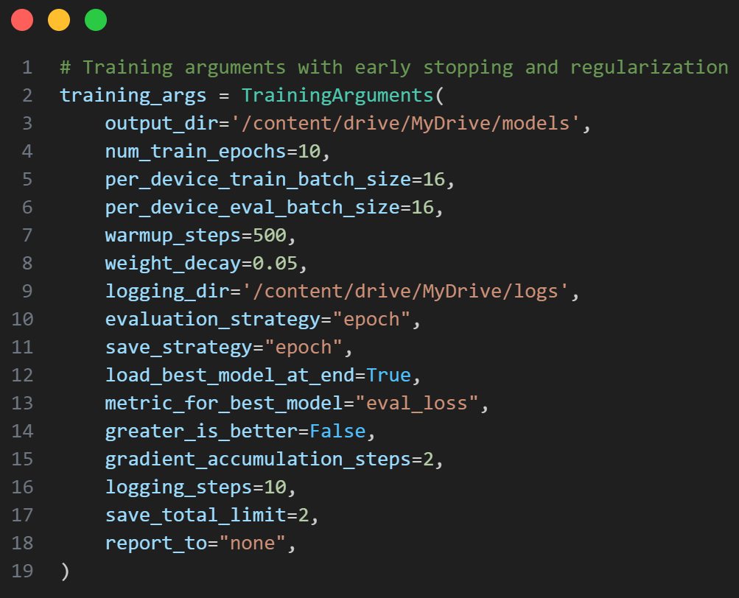
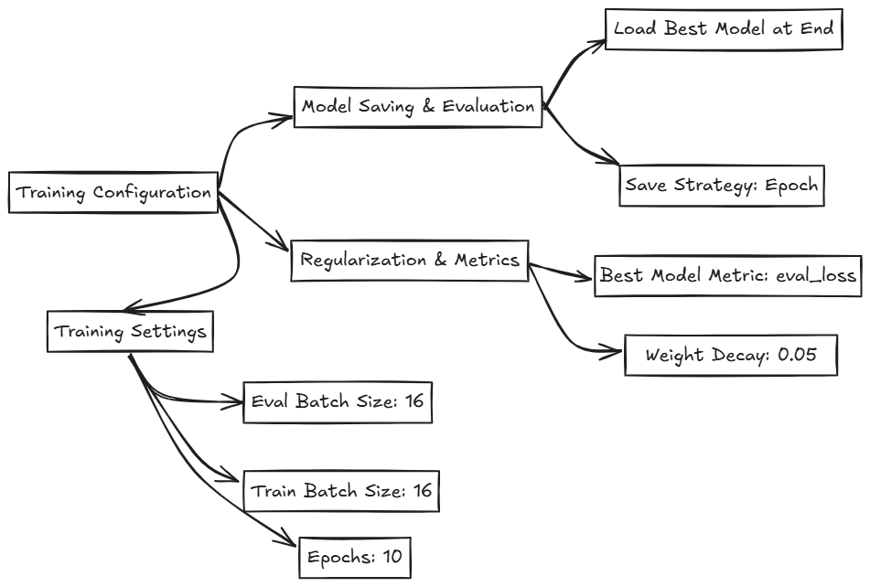
Training Arguments

Slide 31
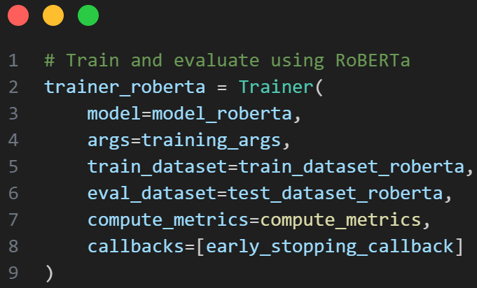
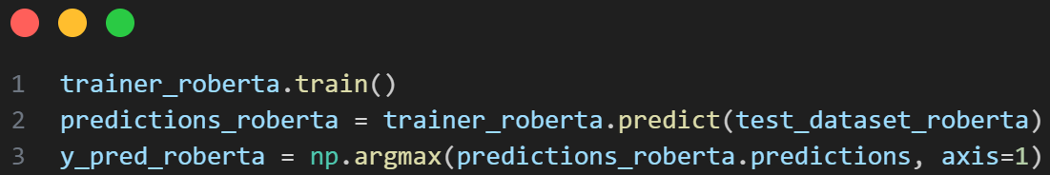
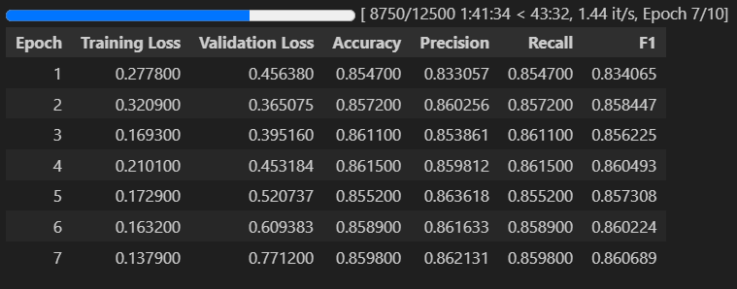
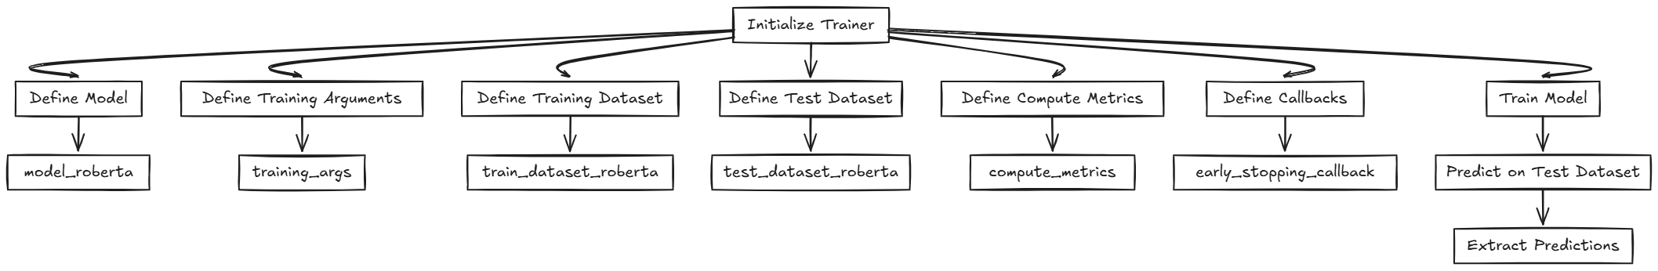
Trainer Model

Slide 32
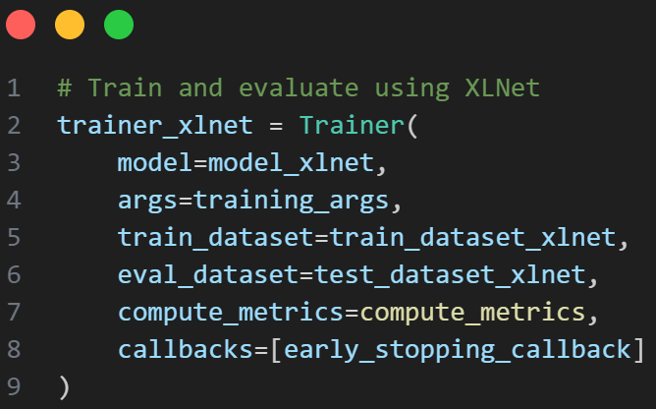
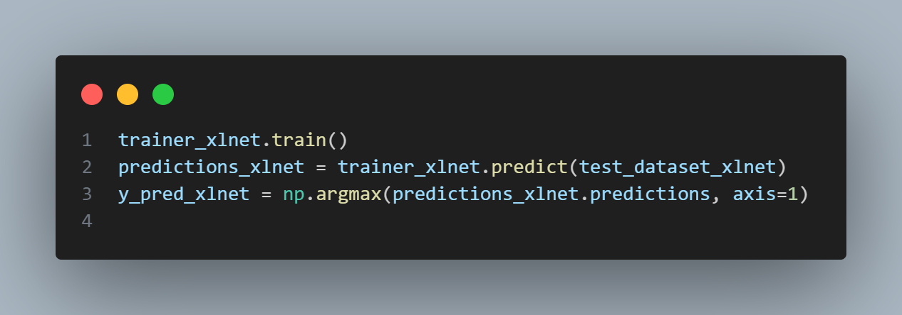
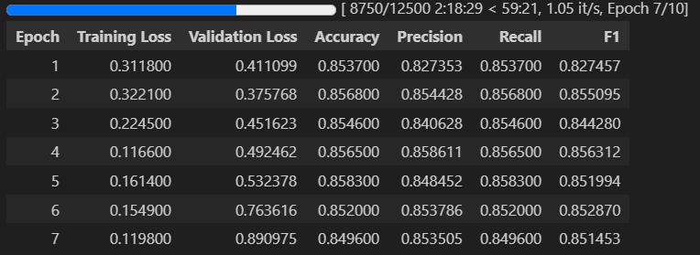
Trainer Model

Slide 33
Trainer Model

Slide 34
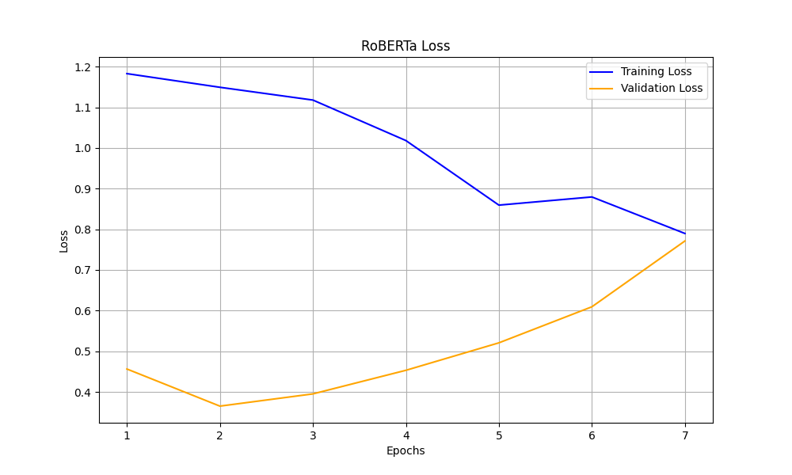
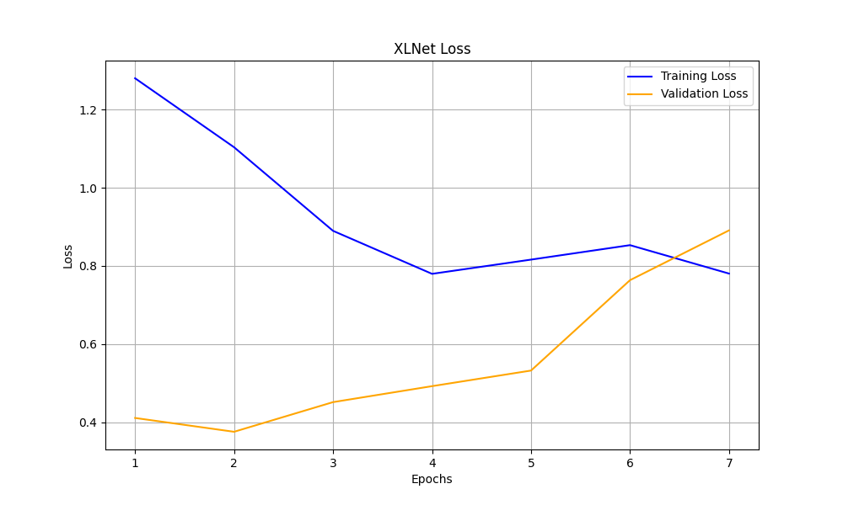
Training and Validation Loss
Both models show a decreasing trend in training loss initially, indicating that they are learning from the training data.
The validation loss for both models increases over time, suggesting potential overfitting as the models become more specialized to the training data.
For both models, early stopping could be considered around epoch 4 or 5, where the validation loss starts to increase more significantly, to prevent further overfitting
while both XLNet and RoBERTa show initial improvements in training loss, RoBERTa demonstrates better generalization to the validation data with a slower increase in validation loss, suggesting it might be more robust against overfitting compared to XLNet.

Slide 35
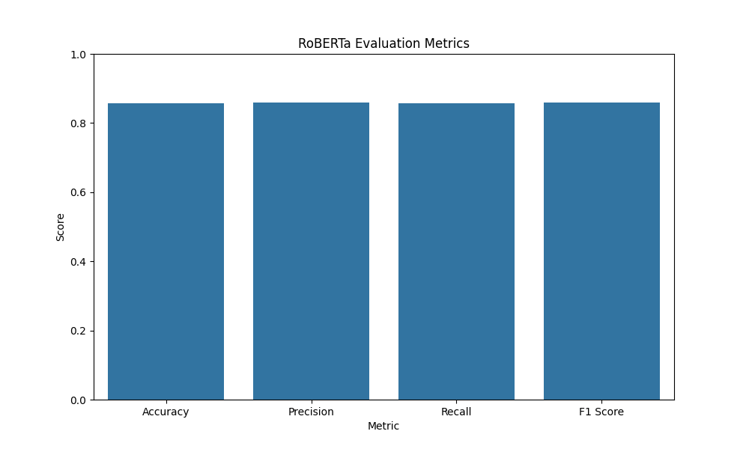
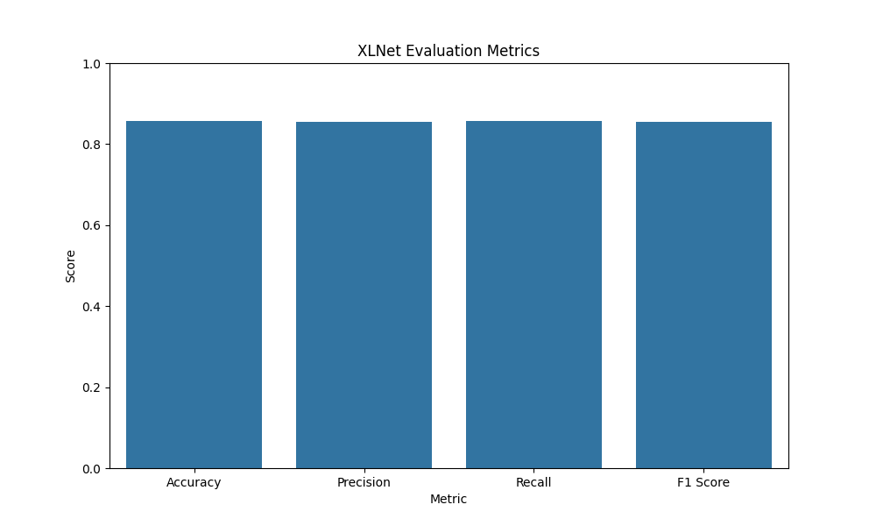
Evaluation Metrics
both XLNet and RoBERTa demonstrate very similar performance across all evaluated metrics, with scores around 0.85 for accuracy, precision, recall, and F1 score. This suggests that both models are equally effective in this particular classification task based on the provided evaluation metrics.

Slide 36


Confusion Matrix
while both models show strong performance in classifying sentiments, RoBERTa demonstrates slightly better accuracy and fewer misclassifications, particularly in neutral and positive categories.

Slide 37

Comparison of Models
RoBERTa and XLNet outperform the traditional machine learning models (Logistic Regression, Random Forest, and SVM) across all metrics. RoBERTa shows the best overall performance with the highest accuracy, precision, recall, and F1 Score, indicating it is the most effective model for this classification task among the ones compared. XLNet also performs very well, closely following RoBERTa in all metrics.

Slide 38

Customer Reviews Sentiment Analysis Interface

Slide 39
Conclusion
We focus on building a robust sentiment classification system to analyze customer reviews using advanced machine learning techniques. By leveraging classical models like Logistic Regression and cutting-edge transfer learning models such as RoBERTa and XLNet, the system achieved superior performance. Key phases included data preprocessing, feature engineering, and model evaluation, paving the way for impactful applications in customer sentiment analysis.

